Slide 1

Welcome to Year 4
Mrs Harwood – Mon, Tues, Weds and Thurs
Mrs Foster - Fri
Miss Osborne – Mon-Fri AM
Miss D’Agostino – Mon-Thurs PM
Mrs Turner – Mon-Fri AM
Mrs Croft – Thurs and Fri PM

Slide 2
Our class
Classroom organisation is a mixture of whole class, group, paired and individual teaching. There is an emphasis on children working with each other in creative and varied ways as often as possible.
Therefore, groupings are flexible and will change to reflect the work being undertaken. In year 4 we use learning partners to promote our learning; these will be changed approximately every two/three weeks.

Slide 3
Curriculum, Timetable and Year Plans
Day | 8:40 – 8:55 | 9:00 – 9:20 | 9:20 – 10:20 | 10:20 – 10:40 | 10:45 – 11:00 | 11:00 – 12:00 | 12:00 – 1:00 | 1:00 – 1:15 | 1:15 – 1:25 | 1:25 – 2:05 |  | 2:05 – 2:45 | 2:50 – 3:10 | 3:10 – 3:15
Monday Break duty | Register and maths fluency | Spelling | Maths | Break | Whole class reading | English | Lunch | Class story | Mastering number | History |  | French | Collective worship | Notices
Tuesday | Register and maths fluency | Swimming |  | Break | Spelling | English | Lunch | Class story | Mastering number | Maths |  | Computing | Collective worship | Notices
Wednesday Break duty | Register and maths fluency | Spelling | Maths | Break | Whole class reading | English | Lunch | Class story | Mastering number | Science |  | PE | In class worship | Notices
Thursday | Register and maths fluency | Spelling | Maths | Break | Whole class reading | English | Lunch | Class story | Mastering number | RE |  | Life skills | Collective worship (singing) | Notices
Friday Mrs Foster | Register and maths fluency | Spelling | Maths | Break | Handwriting | English | Lunch | Class story | Violins |  | Art |  | Collective worship | Notices

Slide 4


Slide 5
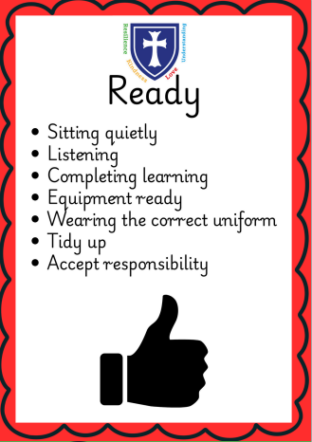
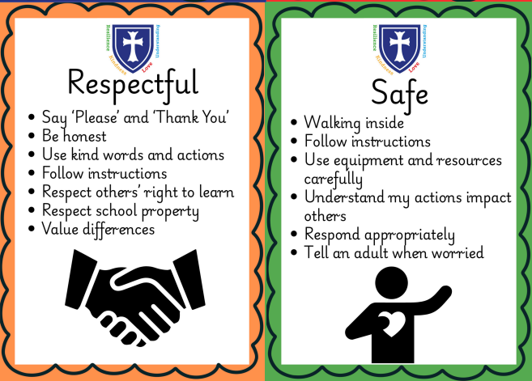

Slide 6
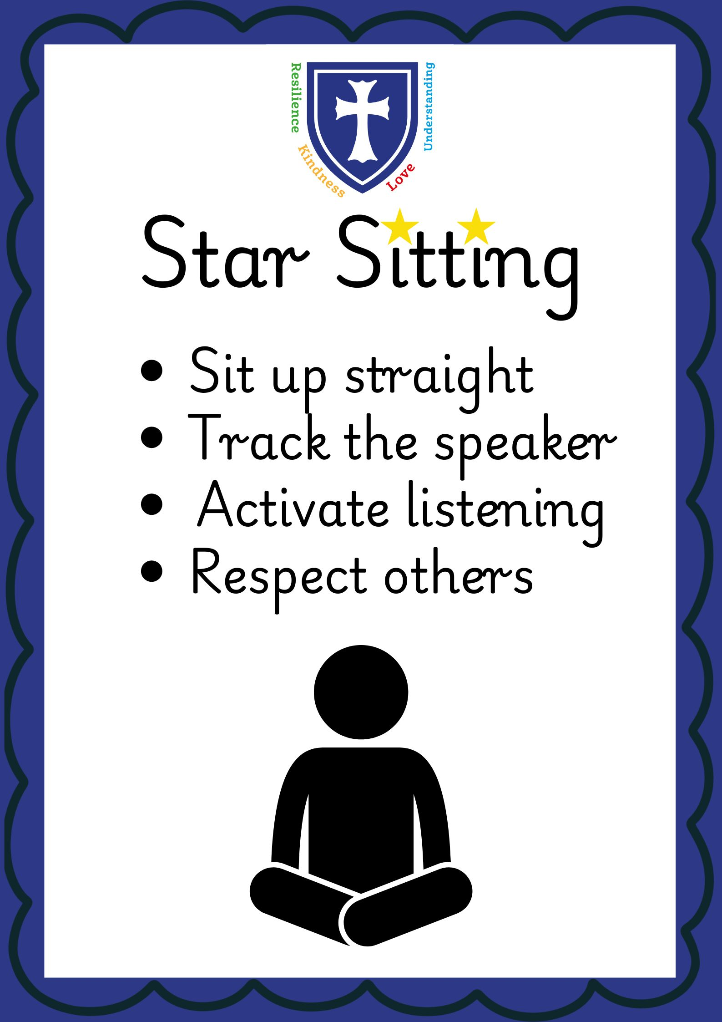
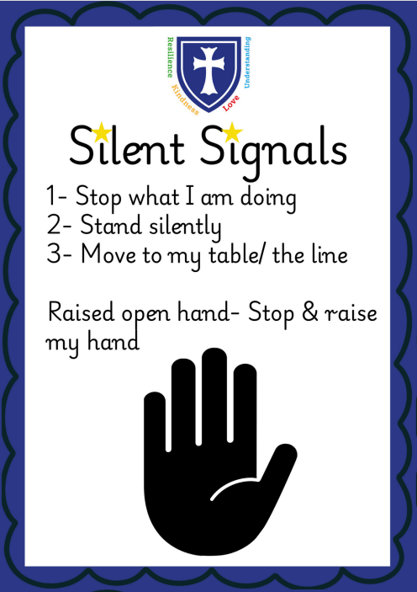

Slide 7
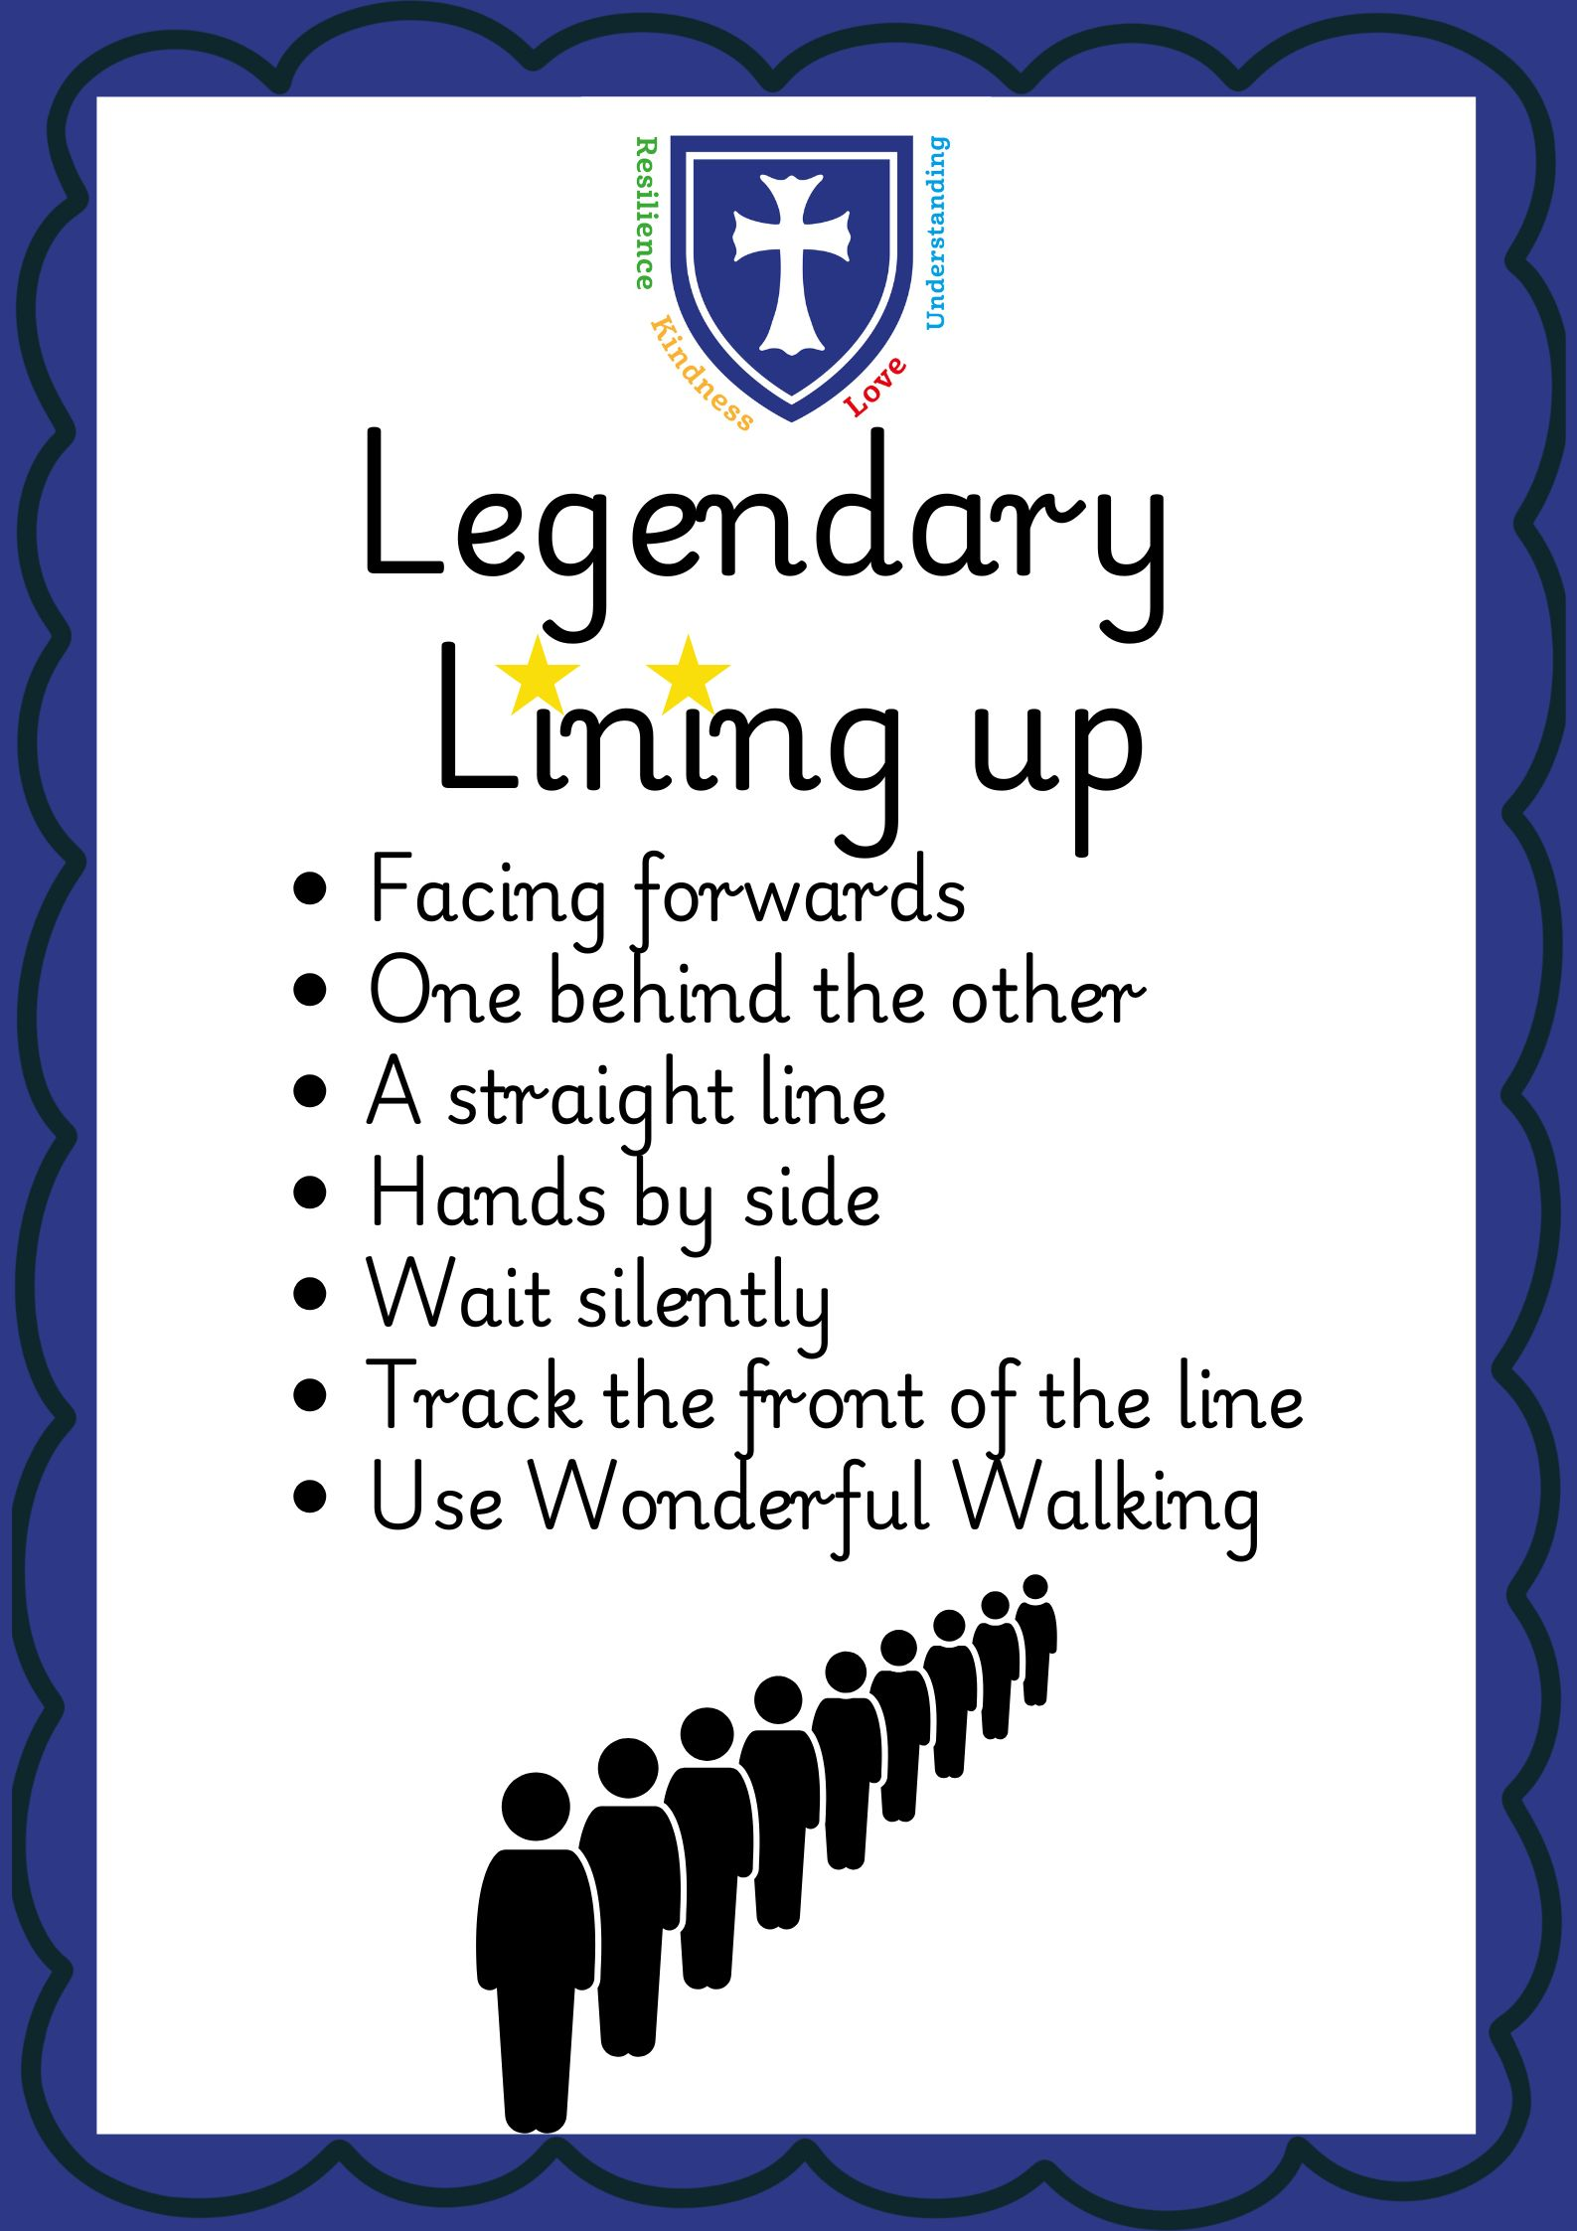
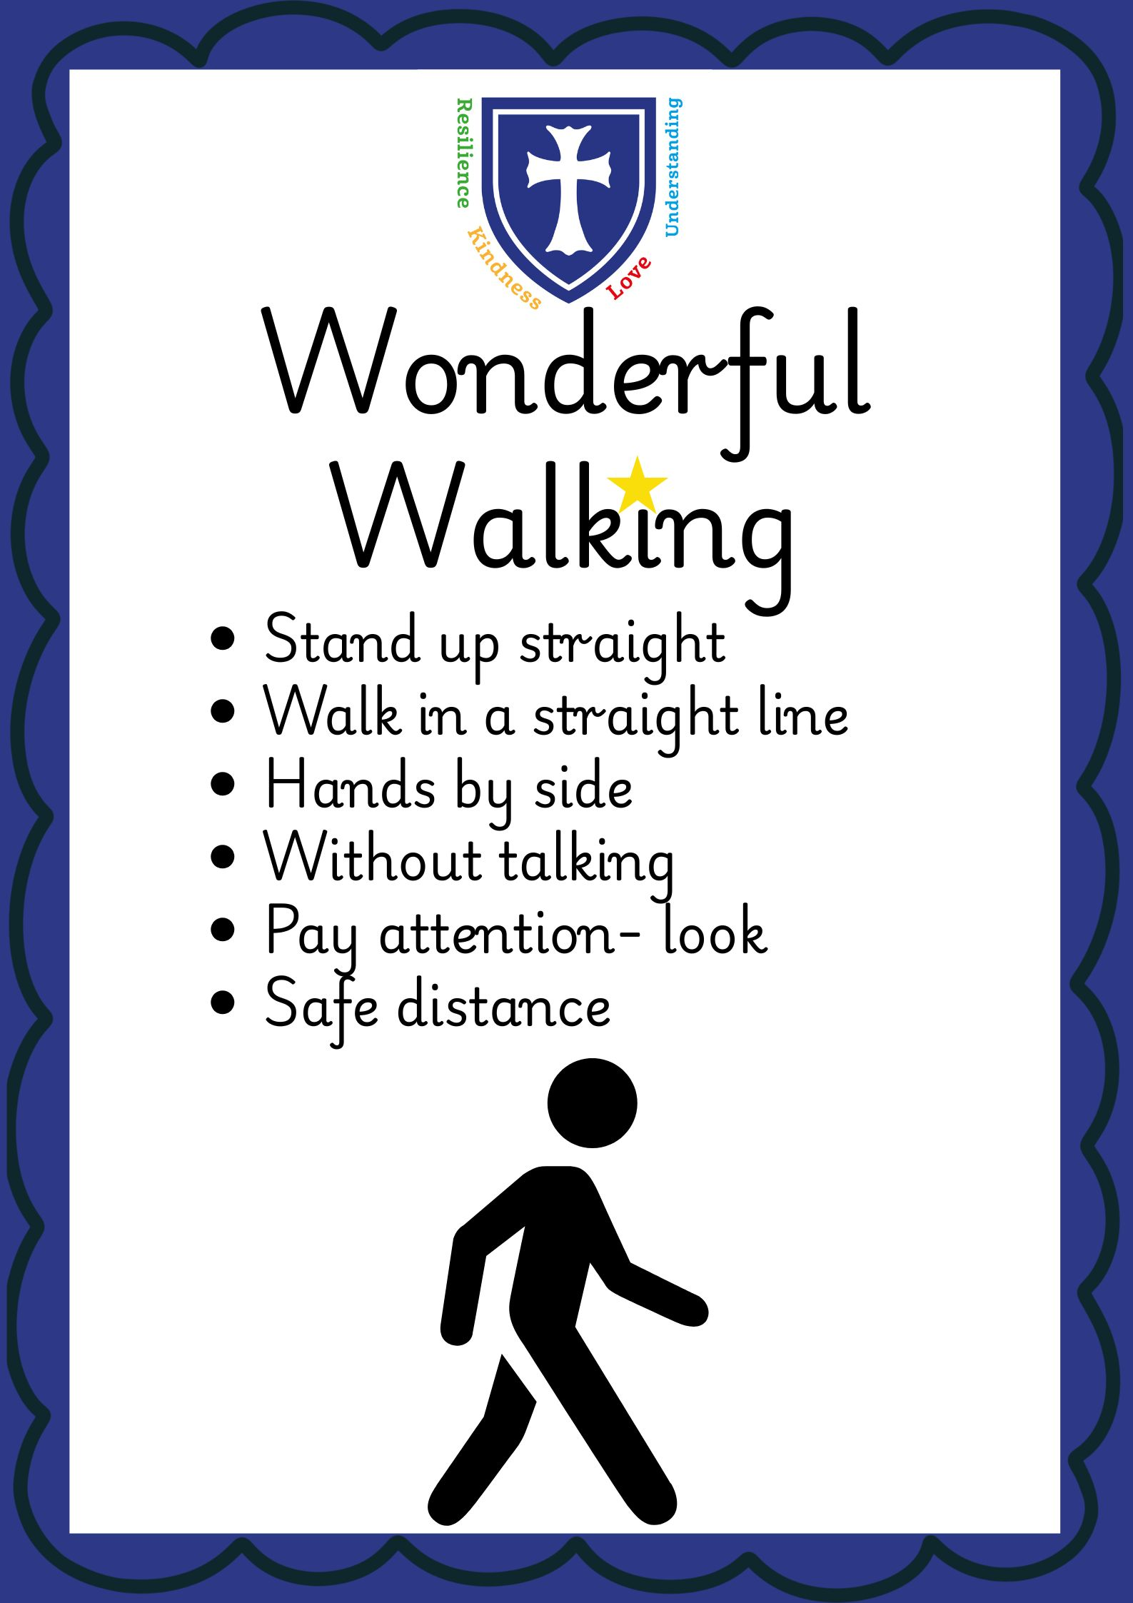

Slide 8
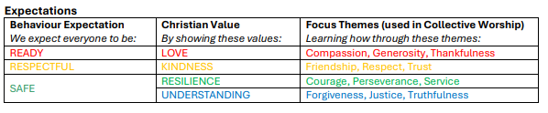

Slide 9
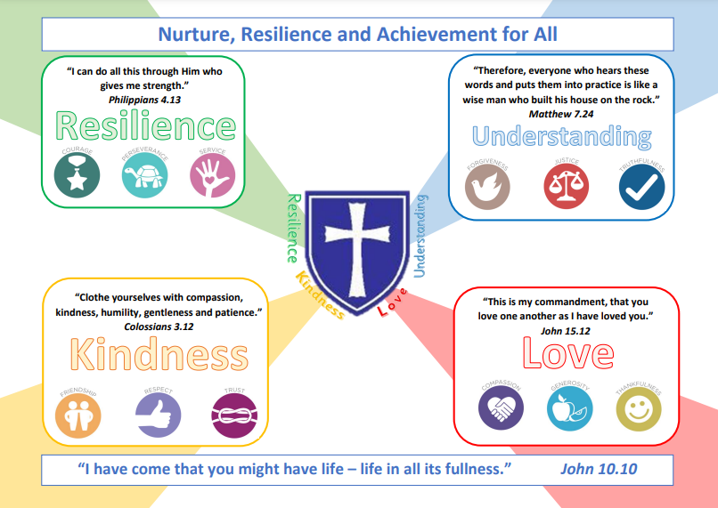
Our School Values

Slide 10
Expectations and behaviour
As you can see from the curriculum plans, there is a lot to work through and expectations are high. Each child is expected to ‘try their best’ in every aspect of their school life, including class-work, behaviour and attitude to others. They are also expected to follow the school’s values.
We follow the school’s Positive Relationship and Behaviour Policy; the policy is available on the website.
Please ensure that no items from home are brought into school unless requested by the class teachers.

Slide 11
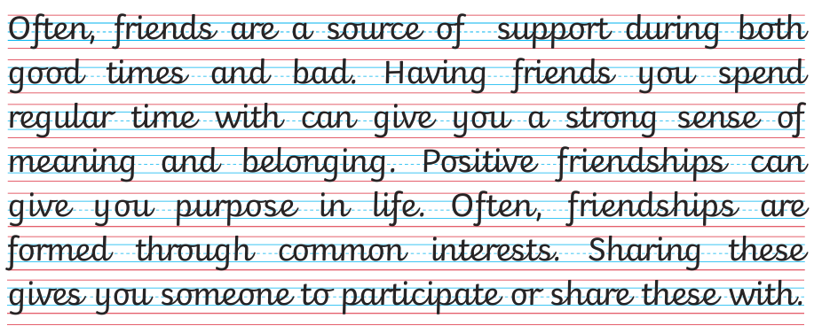
Expectations and behaviour
Presentation
All students are expected to complete their work with joined handwriting that is legible, neat and sitting on the line.
We follow the journey to cursive writing scheme – no looped/joined f,y,g,j,
Please ensure that this is encouraged at home as well. We will be spending time working hard on our presentation in Year 4 and it will be great for your children to have this recognised at home too.

Slide 12




What to bring to school.

Slide 13
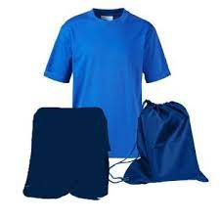

PE KIT
P.E. kit on Tuesday (swimming) and Wednesday.

Slide 14
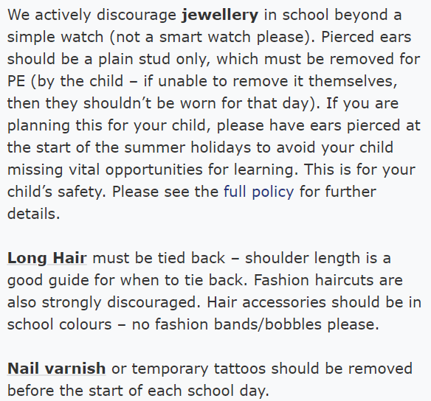
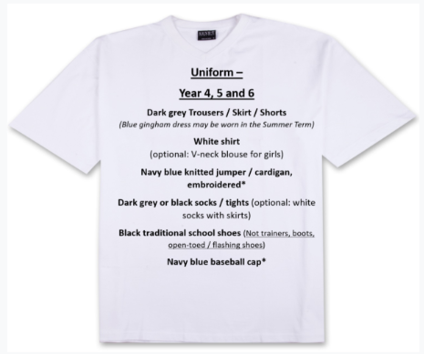
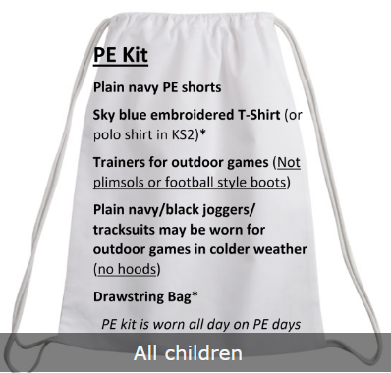
Uniform

Slide 15
Parent Handbook
There is a comprehensive ‘Parent Handbook’ prepared each year with information about:
Home/School Communication (PLEASE read the fortnightly Newsletter!)
Parent Consultations (Pupil Reviews)
School meals
Uniform
Dropping off/collection arrangements
Breakfast Club
After School Clubs
Punctuality and Attendance (including Holidays in Term Time)
You can find it here: Allsaints.herts.sch.uk - Parents

Slide 16
Reading
Daily Reading: Encourage your child to read to you or another available person every day in order to share in the book(s) they have brought home, even if they are a fluent reader! Listen to them read, or read together (taking it in turns, or you reading to them), and then discuss the book/section together. This ensures that your child has fully understood what they have read and not simply ‘listed’ words on a page.
All children are given a book to read at home. This will be from a specific book band (matched to phonics stage) or section of the library (for those beyond specific phonics teaching). Within the band/section, children have free choice or if they’re struggling may be guided to choose something they might like.
Choosing the same book to read again is OK! In fact, in the OFSTED Reading Framework (2021), they reiterate what teachers have known for a long time: re-reading of a text improves accuracy and fluency which leads to stronger comprehension (think about how children love to hear the same stories, play with the same toy, or do the same thing over and over again when very young…). Of course, variety is also good…

Slide 17
Reading
In year 4 children are encouraged to change their own books when they have finished. They can choose from the school library or the books available in the classroom. Please sign the reading record book when you have read with your child and we would love it if you could aim to do this every day. If children read to themselves they can mark down which pages they have read and sign it themselves but please make sure you are monitoring this.
Reading for pleasure books are a book of your child’s choosing to be enjoyed independently or together but they must read their levelled books out loud with an adult.
We aim to listen to every child read regularly.

Slide 18
Reading
Phonics / Spelling: During autumn term, we will spend time looking at the Year 3 and 4 statutory words and spelling patterns. We will revise the common misconceptions from high frequency words and phonics that they already know and use these to build understanding of other patterns.
We will be following the same spelling pattern that the children were used to in year 3 with 15 words for two weeks and investigations and activities to learn the patterns within those words.
Spellings will be sent home with the children every two weeks on a Friday through Google Classroom with ideas of activities they can do to help them learn. The children are encouraged to identify what parts of the words make it tricky for them to spell through their own investigations.

Slide 19

Reading

Slide 20
Homelearning
Set Friday
Due Thursday.
We set weekly tasks on a Friday on Google Classroom.
Homework will consist of pages in the maths homelearning books (in a similar format to last year and based on topics covered in school that week), spellings, reading and TTRS.
If a sheet is required, it will be given to the children on a Friday. It will also be available on Google Classroom in case of the sheet being lost! All tasks are due to be completed and in school by the following Thursday (spellings are bi-weekly). All instructions for the home learning will be shared with the class on Fridays.

Slide 21
Homelearning resources
BBC Bitesize
Whiterose website has a section dedicated to homelearning with videos to support any understanding.
Please also sign up to use the Bishop’s Stortford library. It is free!!

Slide 22

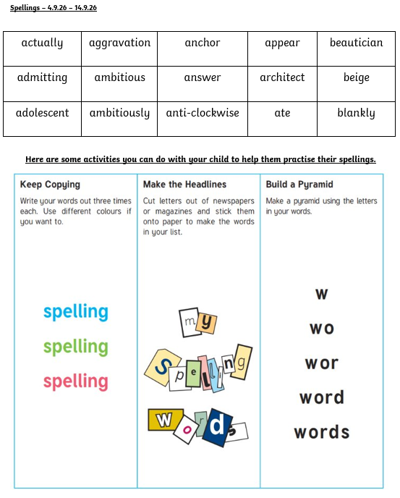
Expectations at home
Reading with an adult.
Practice times tables.
Practice spellings.

Slide 23
What can you do to help?
Practice spellings.
Practice times tables.
Practice handwriting.
Read with your children and ask them questions about their reading.
Encourage them to be resilient and persevere.
Encourage them to communicate if they are finding something too tricky.
Keep in contact.

Slide 24
Any questions?

